Slide 1
Image Enhancement in the Frequency Domain (2)

Slide 2
Frequency Domain Filtering
Steps of filtering in the frequency domain
  Calculate the DFT of the image f
  Generate a frequency domain filter H
    H and F should have the same size
    H should NOT be centered. Centered H is for displaying purpose only.
    If H is centered, F needs to be centered too and some post-processing is required (textbook pp158-159)
  Multiply F by H (element by element)
  Take the real part of the IDFT

Slide 3
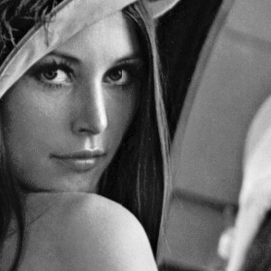
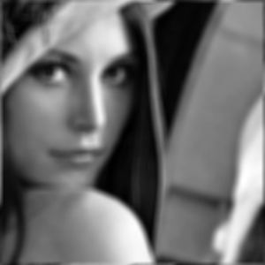

Construction of Frequency Domain Filters from Spatial Domain Filters
Ex: Given an image f and an 9×9 spatial filter as shown on the right
  Result of spatial filtering using the MATLAB command imfilter(f,h,’conv’,’circular’,’same’) is shown below
  We would like to perform the same filtering but in the frequency domain
1
1
1
1
1
1
1
1
1
1
1
1
1
1
1
1
1
1
1
1
1
1
1
1
1
1
1
1
1
1
1
1
1
1
1
1
1
1
1
1
1
1
1
1
1
1
1
1
1
1
1
1
1
1
1
1
1
1
1
1
1
1
1
1
1
1
1
1
1
1
1
1
1
1
1
1
1
1
1
1
1

Slide 4
Construction of Frequency Domain Filters from Spatial Domain Filters
Step 1: Zero-padding the spatial domain filter h to make the size the same as the size of the image f (300×300). How?
  Option 1
    The filter is located at the center of the expanded filter (h_exp1)
  Option 2
    The filter is located at the top-left corner (h_exp2)
Which one is correct?
300
9
9
300
9
9
300
300

Slide 5

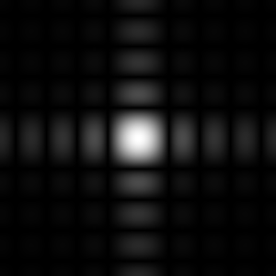
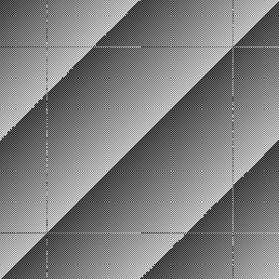
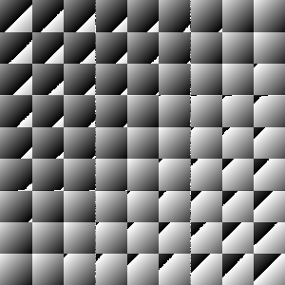
Construction of Frequency Domain Filters from Spatial Domain Filters
Step 2: Obtain the frequency domain representation of the expanded spatial domain filter by taking the DFT
  Results using the following MATLAB commands are shown below
    H=fft2(h_exp);imshow(log(1+abs(H)),[ ]);
    imshow(log(1+abs(fftshift(H))),[ ]);
    Imshow(angle(H),[ ]);
  Notice the spectra are the same for h_exp1 and h_exp2 (from shift property). The difference lies in the phase spectrum
h_exp1
h_exp2

Slide 6
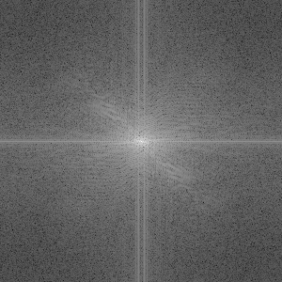
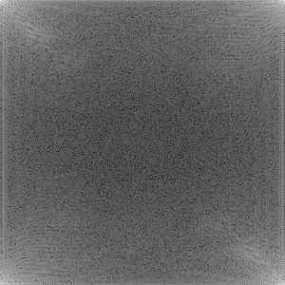
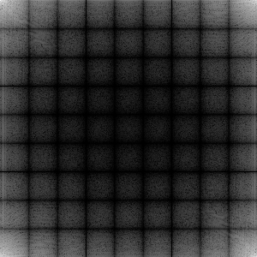
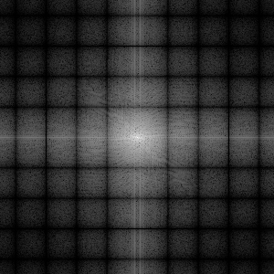
Construction of Frequency Domain Filters from Spatial Domain Filters
Step 3: Multiply the DFT of the image (not centered) by the DFT of expanded h
  Notice that, overall speaking, the high frequency parts of F are attenuated
Centered F
F
H
F∙H
Centered F∙H

Slide 7
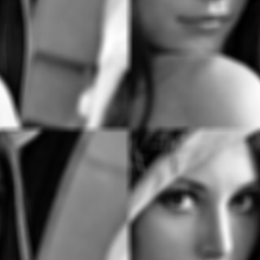

Construction of Frequency Domain Filters from Spatial Domain Filters
Step 4: Take the real part of the IDFT of the results of step 3
From h_exp1
From h_exp2
From spatial domain filtering
Neither one is correct
What is going on?

Slide 8
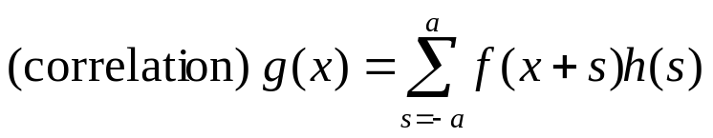
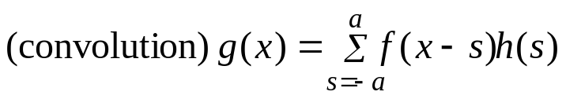
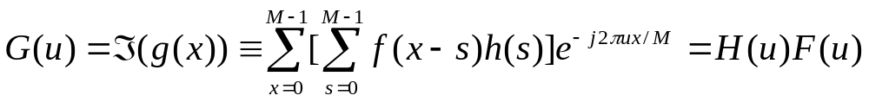
Spatial Filtering vs.
Convolution Theory
Recall the mathematic expression for (1D) spatial filtering in terms of correlation and convolution
For convolution theory
The origin of spatial filter is at the center for spatial filtering while the origin of the filter in convolution theory is at the top, left corner

Slide 9
Spatial Filtering vs.
Convolution Theory
Therefore, to have exactly the same results, the top-left element of the expanded spatial filter used to construct the frequency filter needs to correspond to the center of spatial filter when it is used in spatial domain filtering
9
5
5
5
4
9
300
9
300
9
5
4
4
4
300
300

Slide 10
Homework #5
Write MATLAB codes to construct the equivalent frequency domain filter for a given spatial domain filter
  Input: Spatial domain filter h (odd sized), desired filter size
  Output: Non-centered frequency domain filter H and plot the centered spectrum.
Verify your codes by performing filtering in both spatial and frequency domains and check the results (take the sum of the absolute difference of the two resulting filtered images)

Slide 11
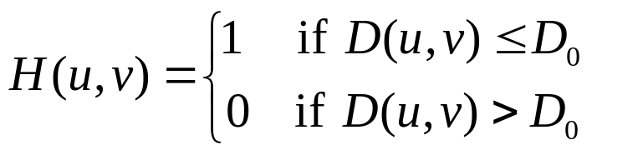
Direct Construction of Frequency Domain Filters
Ideal lowpass filters (ILPF)
  Cut off all high-frequency components of the Fourier transform that are at a distance greater than a specified distance D₀ (cut off frequency) from the origin of the (centered) transform
  The transfer function (frequency domain filter) is defined by
  D(u,v) is the distance from point (u,v) to the origin (center) of the frequency domain filter
  Usually, the image to be filtered is even-sized, in this case, the center of the filter is (M/2,N/2). Then the distance D(u,v) can be obtained by

Slide 12
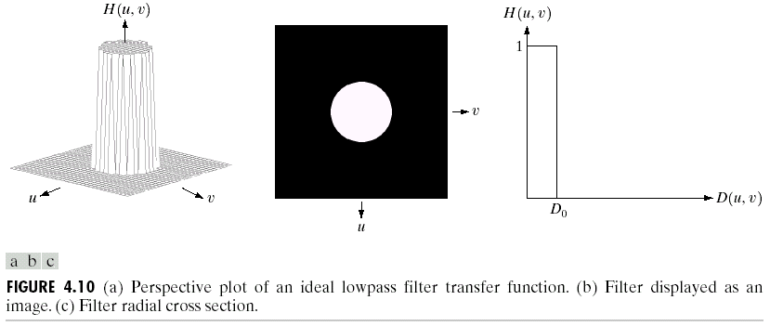
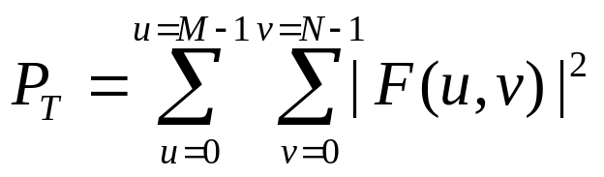
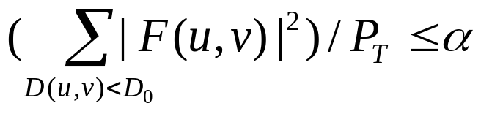
How to determine the cutoff frequency D₀?
  One way to do this is to compute circles that enclose specified amounts of total image power P_{T}.

Slide 13
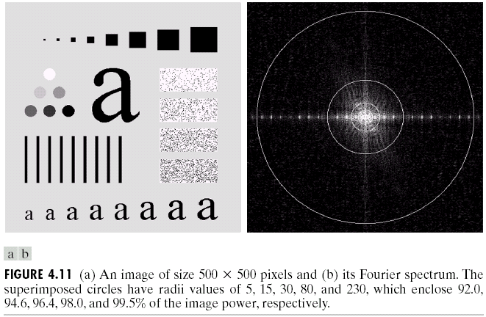
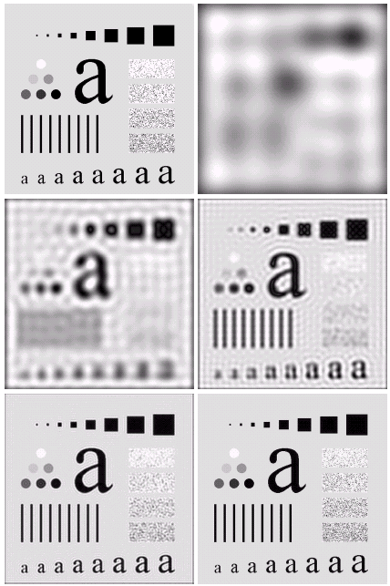
As the filter radius increases, less and less power is removed/filtered out, more and more details are preserved.
Ringing effect is clear in most cases except for the last one.
Ringing effect is the consequence of applying ideal lowpass filters

Slide 14
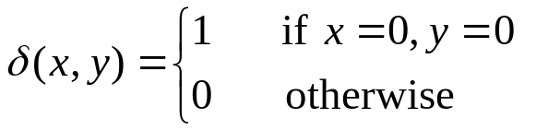
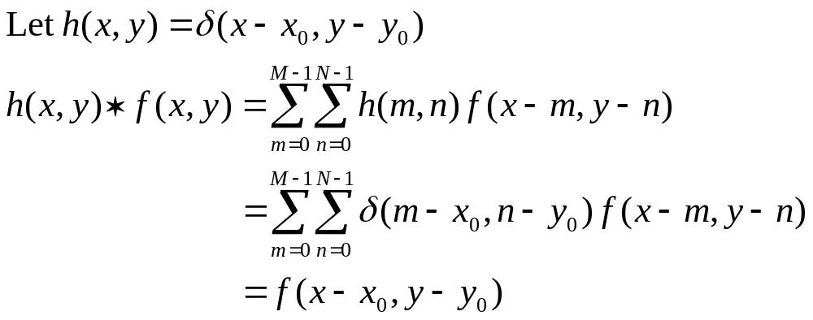
Ringing Effect
Ringing effect can be better explained in spatial domain
Convolution of a function with an impulse “copies” the value of that function at the location of the impulse.
  An impulse function is defined as

Slide 15
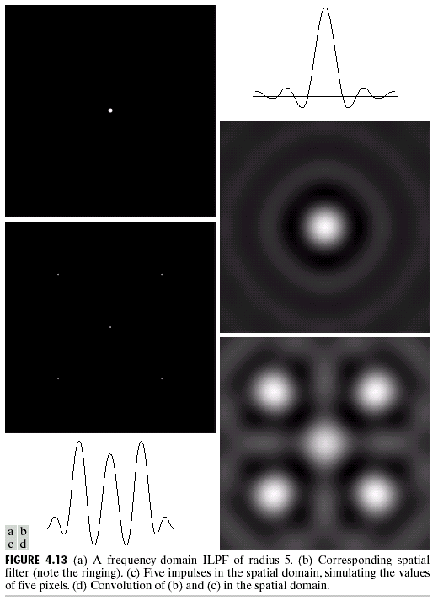
The transfer function of the ideal lowpass filter with radius 5 is ripple shaped
Convolution of any image (consisting of groups of impulses of different strengths) with the ripple shaped function results in the ringing phenomenon.
Lowpass filtering with less ringing will be discussed.

Slide 16
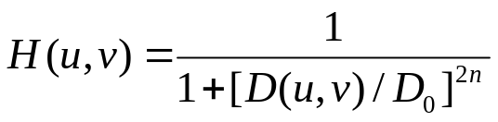
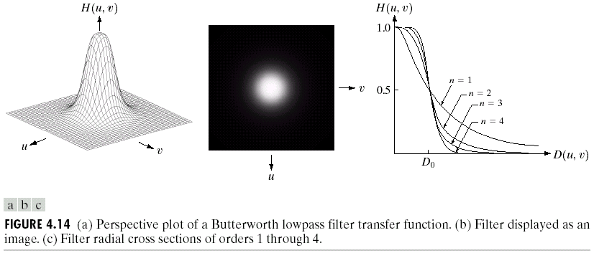
Butterworth Lowpass Filters
A butterworth lowpass filter (BLPF) of order n with cutoff frequency at a distance D₀ from the origin is given by the following transfer function
  BLPF does not have a sharp discontinuity
  For BLPF, the cutoff frequency is defined as the frequency at which the transfer function has value which is half of the maximum

Slide 17
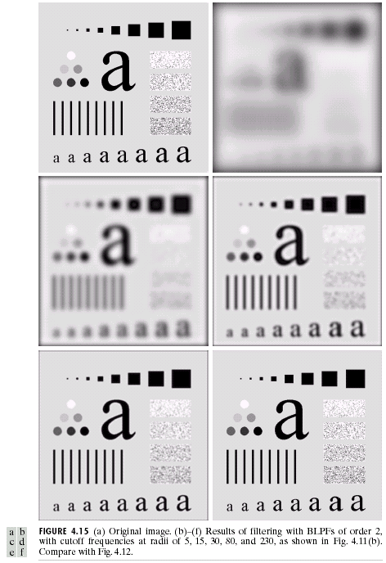
Examples of Application of BLPF
Same order but with different cutoff frequencies
  The larger the cutoff frequency, the more details are reserved

Slide 18
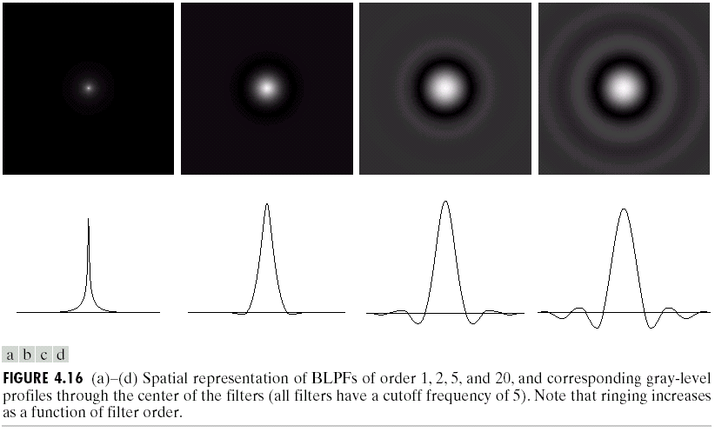
Butterworth Lowpass Filters
To check whether a Butterworth lowpass filter suffer the ringing effect as dose the ILPF, we need to examine the pattern of its equivalent spatial filter (How to obtain it?)

Slide 19
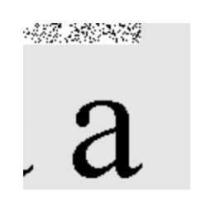
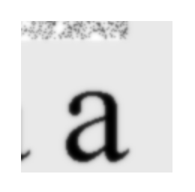






Original
D₀=80, n=1
D₀=80, n=2
D₀=80, n=3
D₀=80, n=5
D₀=80, n=10
D₀=80, n=20
D₀=80, n=50

Slide 20
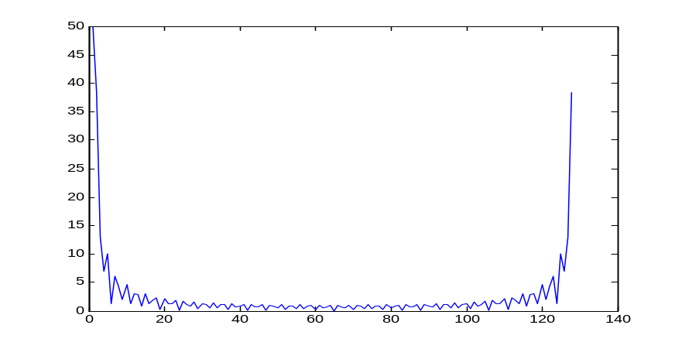
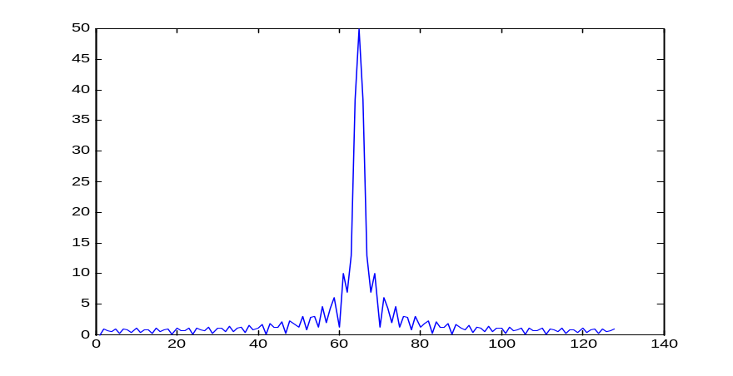
How to Obtain a Spatial Filter From Its Centered Frequency Domain Filter?
fftshift
ifftshift
Back to back representation
Centered representation
Circularly shifted by 4 ( (M-1)/2 )
f(x)➔f(x)∙e^{-j2πu4/9}
Done by fftshift
0
1
2
3
4
5
6
7
8
5
6
7
8
0
1
2
3
4
Circularly shifted by -4 or 5
f(x)➔f(x)∙e^{-j2πu5/9}
Done by ifftshift
After restoring to the back to back form, perform IDFT to obtain the spatial filter (back to back form)

Slide 21
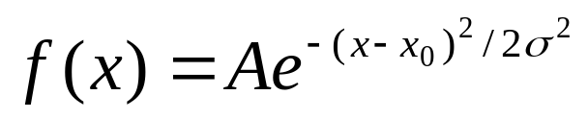
Gaussian Lowpass Filters
1D Gaussian distribution function is given by
  X₀ is the center of the distribution
  σ is the standard deviation controlling the shape (width) of the curve
  A is a normalization constant to ensure the area under the curve is one.
  The Fourier transform of a Gaussian function is also a Gaussian function

Slide 22
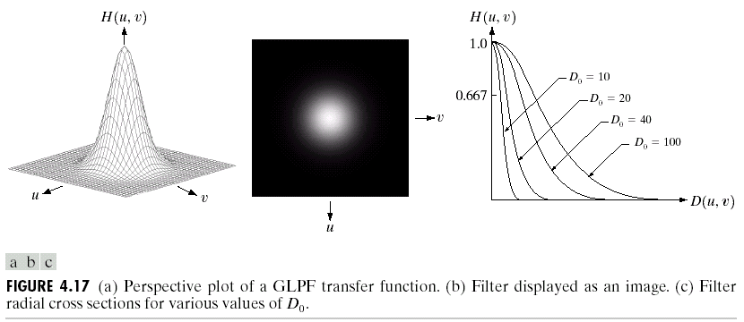
Gaussian Lowpass Filters
GLPF is given by the following (centered ) transfer function
  (u₀,v₀) is the center of the transfer function
  It is [M/2, N/2] if M,N are even and [(M+1)/2,(N+1)/2] if M,N are odd numbers
  Dose GLPF suffer from the ringing effect?

Slide 23
Homework #6
Let g(x)=cos(2πfx), x=0,0.01,0.02,…0.99
  Plot the signal g(x)
  Plot the spectrum of g(x) for f=1, 5, 10, 20
  Plot the centered spectrum
  Plot the signal g’(x) whose spectrum is the centered spectrum of g(x)
  Plot the spectrum of g₂(x)=1+g(x)
  How do we get g(x) from g₂(x) using frequency domain filtering?

